Slide 1
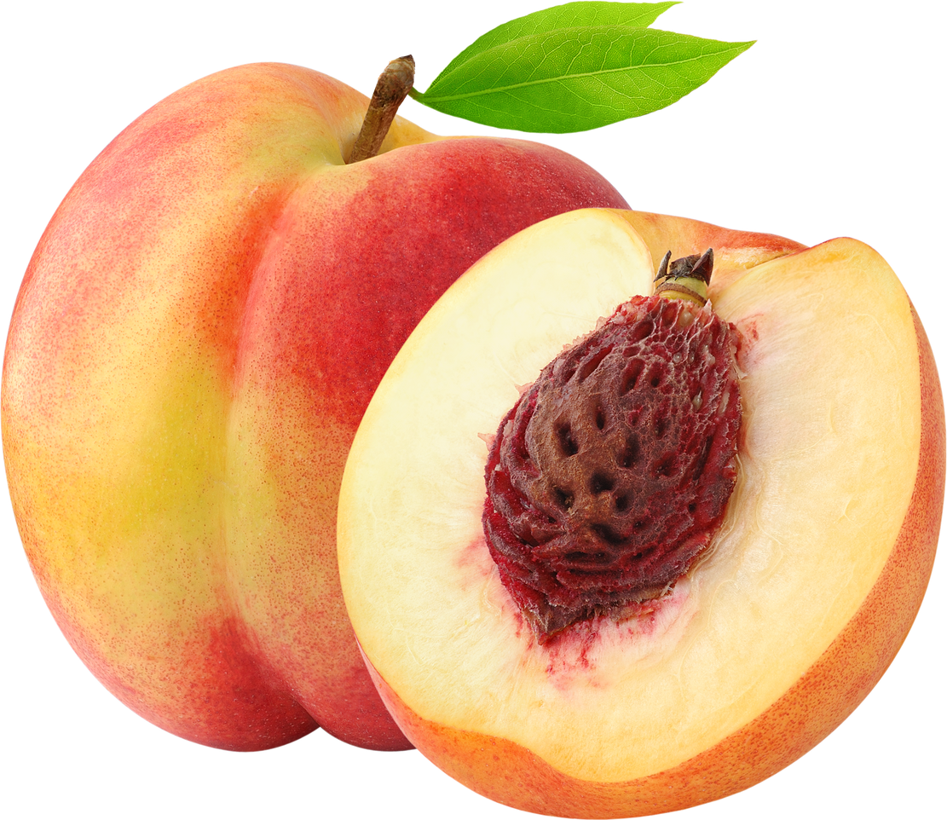

Slide 2
Stem End
Shoulders
Suture
Pit
Cheek
Flesh
Tip (Blossom End)

